Slide 1
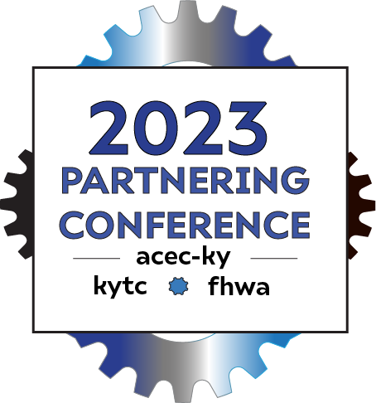
OPENROADS DESIGNER (ORD)
What to Model and How to Get Paid for It!!
Eric Pelfrey, P.E. – Director, Professional Services
Matt Sipes, P.E. – Branch Manager, Highway Design

Slide 2
Openroads designer (ord)
Welcome to Open Roads Designer, a powerful civil engineering software that is revolutionizing the way we design and build roads and infrastructure. With its innovative features and user-friendly interface, Open Roads Designer is expected to become the ultimate tool for modern road design.
…but not without some complications

Slide 3
Implementation
10/23/19 A Project Development Memorandum was announced that released a brand-new set of CADD Standards for ORD and showed the statement below.
Professional Services Requests for Proposal include the following Method of Design specifications for ORD standards and plan submittal

Slide 4
Features & Tools
3D Modeling & BIM Workflow
Creating 3D models of integrated road infrastructure with ease, Open Roads Designer provides a more engaging view for design engineers and support BIM workflows.
Improved design productivity and reduced errors
Open Roads Designer provides intelligent roadway design tools that save time, streamline workflow, and help reduce errors and omissions, which translate to cost savings and efficient usage of resources.
Enhanced safety and operations
Designing using Open Roads Designer, safety and operations considerations are
incorporated, improving the safety and operational efficiency of the project.
Real-time data
Generate real-time data for reviewing the design alternatives and
conducting detailed analyses for existing and future conditions.
RESEARCH
ABSTRACT
DESIGN

Slide 5
Back to reality

Slide 6
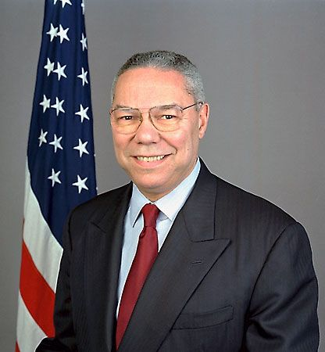
“Don’t take action if you only have enough information to give you less than 40% chance of being right. But don’t wait until you have enough facts to be 100% sure because by then it is almost always too late. Once the information is in the 40% to 70% range go with your gut.”
General Colin Powell, former Secretary of State

Slide 7
ORD Implementation
Contracts were still negotiated using the longtime production hour worksheets
Had not been updated since 2014

Slide 8
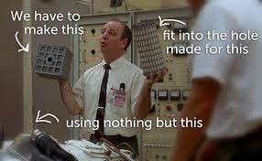
ORD Implementation
The spreadsheet just didn’t fit the OpenRoads workflow
Couldn’t encompass the level of effort for pieces

Slide 9
ORD Implementing
Early attempts to use the old spreadsheets proved to be more like the wild west.
Consultants and KYTC PMs would put additional items and hours all over the place.
Negotiations were very difficult.

Slide 10
DEVELOPMENT OF NEW WORKSHEET
In early 2022 – Professional Services and Highway Design made it a made it a top priority to update the production hours.
March – Created a Working Group
Consultants through ACEC
KYTC Central Office Staff
District Project Managers

Slide 11
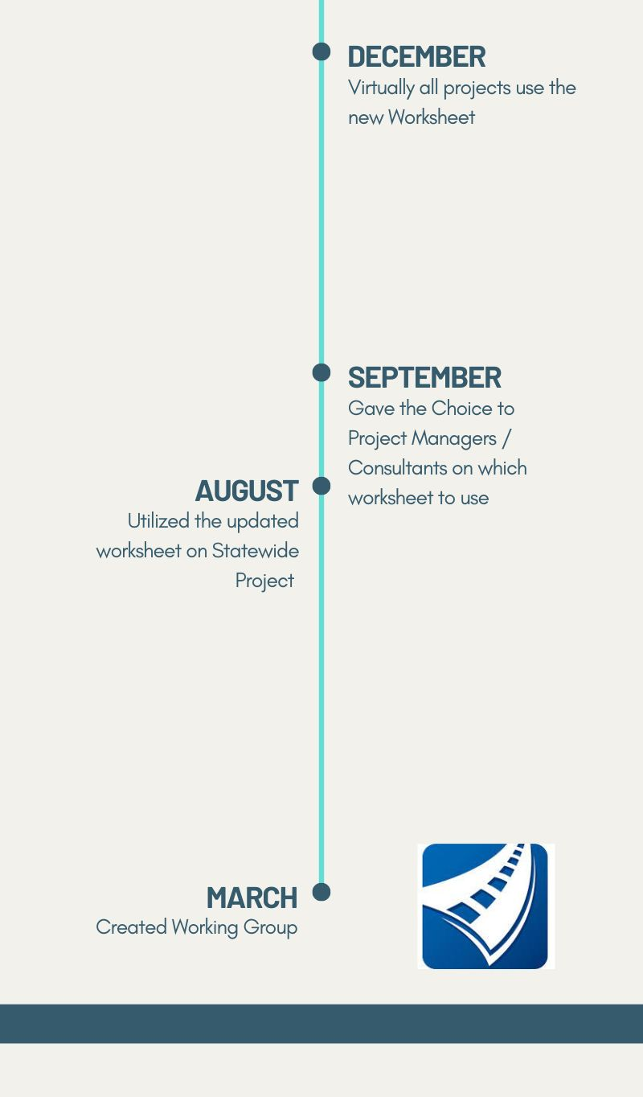
Development of New Worksheet
Completed a handful of projects using the worksheet
Users provided feedback and adjustments were made
By December, most projects utilized the new spreadsheet.

Slide 12
COMPANY OVERVIEW
Utilizing the New
ORD Worksheet

Slide 13
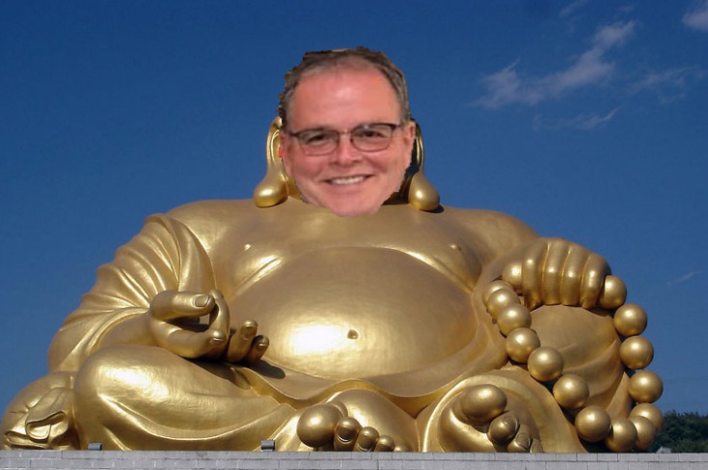
Gormley's guidance
Appropriately scope the Level of Effort and Deliverables
Coordinate with Highway Design's experts for Bentley support
Trends to increase some effort but less for Entrances
Communicate early and often
Miscellaneous Items should be rare
Rescoping meetings can help negotiate differences

Slide 14
New Worksheet
Not going to solve all the problems.
Projects are too varying and complex.
Meant to facilitate discussion with the Project Manager.

Slide 15
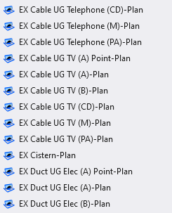
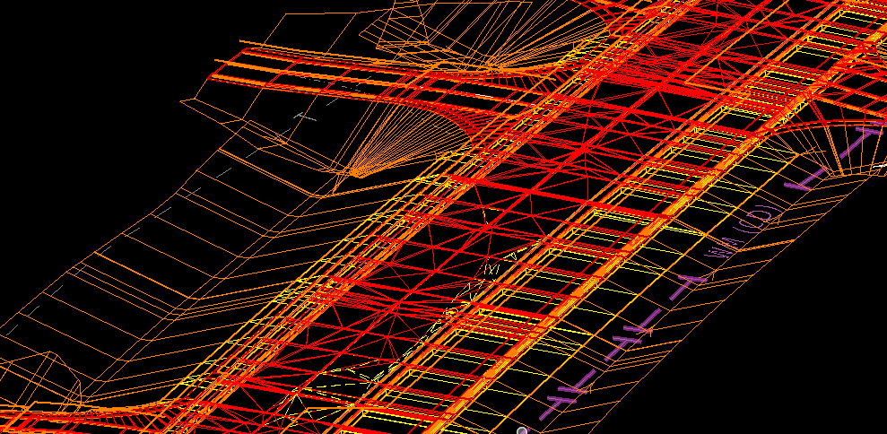
Digging into the New Worksheet - survey
Minimal Changes
Incorporate LiDAR
Other aspects of LiDAR will be added by Direct Cost
Utilities surveyed correctly
will show up in 3d in plan set
automatically.
RESEARCH
ABSTRACT
DESIGN

Slide 16
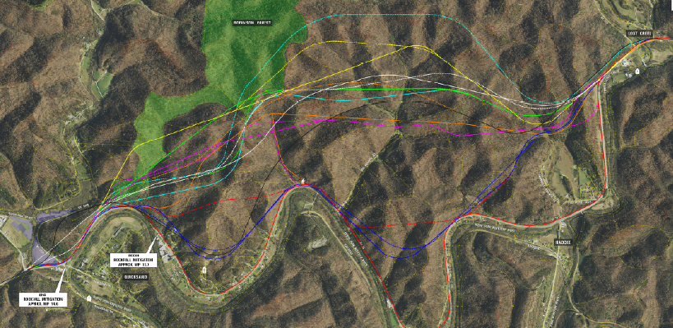
Digging into the New Worksheet – PHASE 1
Goal of Phase 1 is to select Alternative
Minimize Plans
Utilize Manuscripts
Don’t cut cross sections
Model what is necessary to make the decisions
Worksheet really focused on revamping Modeling Items

Slide 17
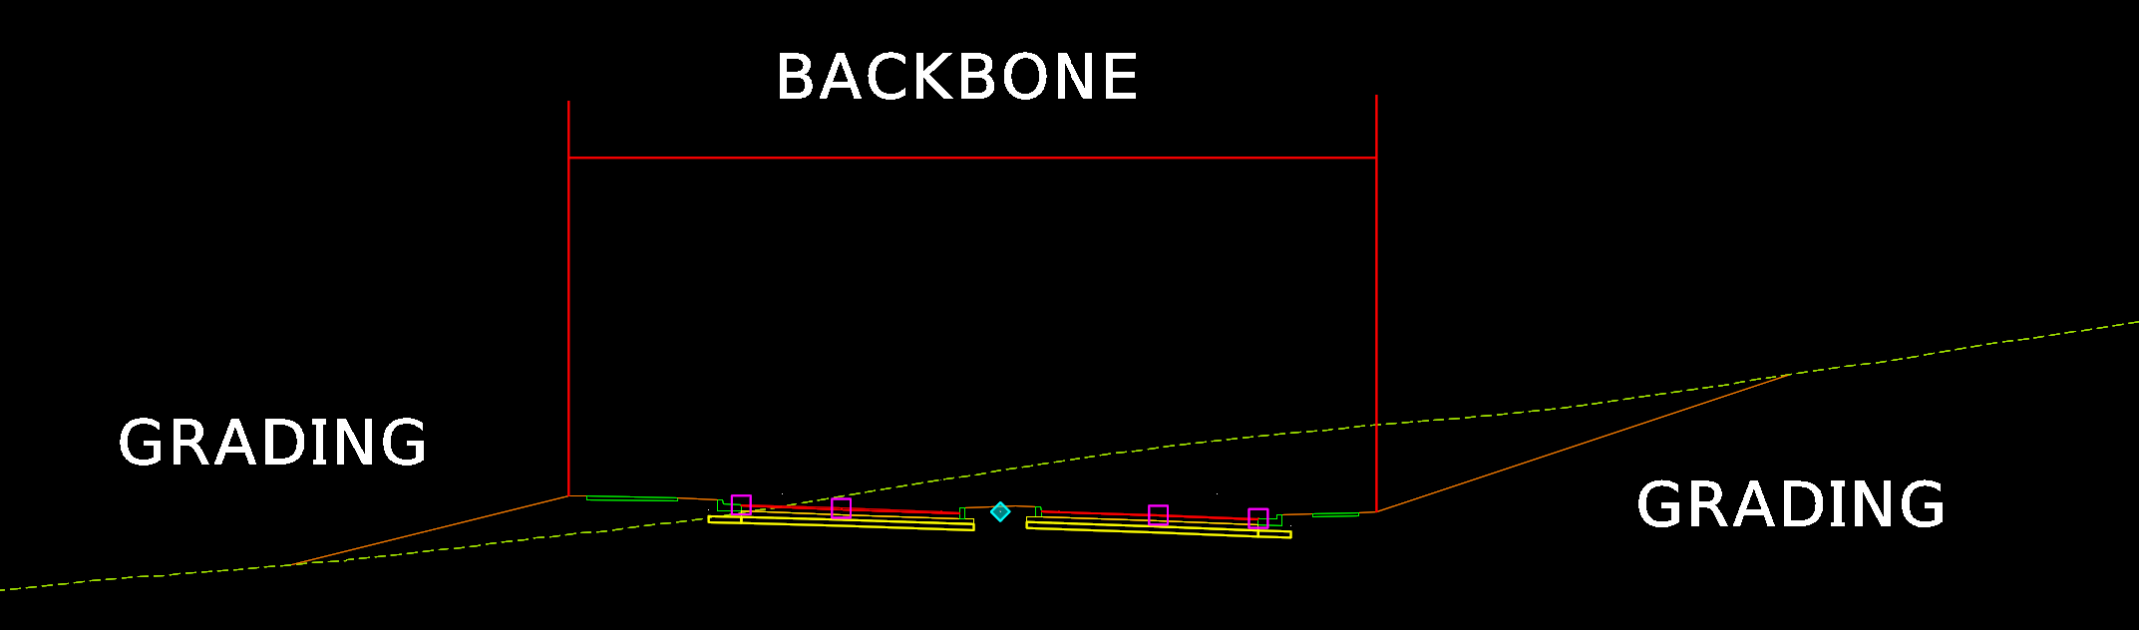
Digging into the New Worksheet - Phase 1
Pulled modeling effort apart
Backbone vs Grading
Merely a way to break down the level of effort

Slide 18
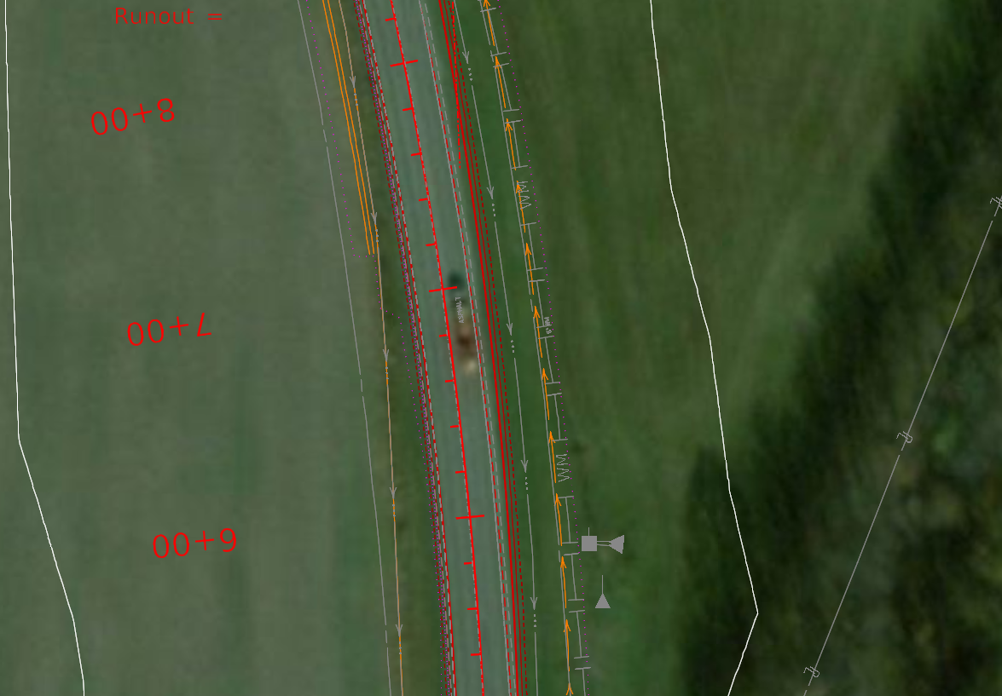
Digging into the New Worksheet - Preliminary Modeling
Backbone modeling
Superelevation
Accurate pavement block
All lane widths and tapers
Shoulder widths
Don’t model radii
Only tie down entrances

Slide 19
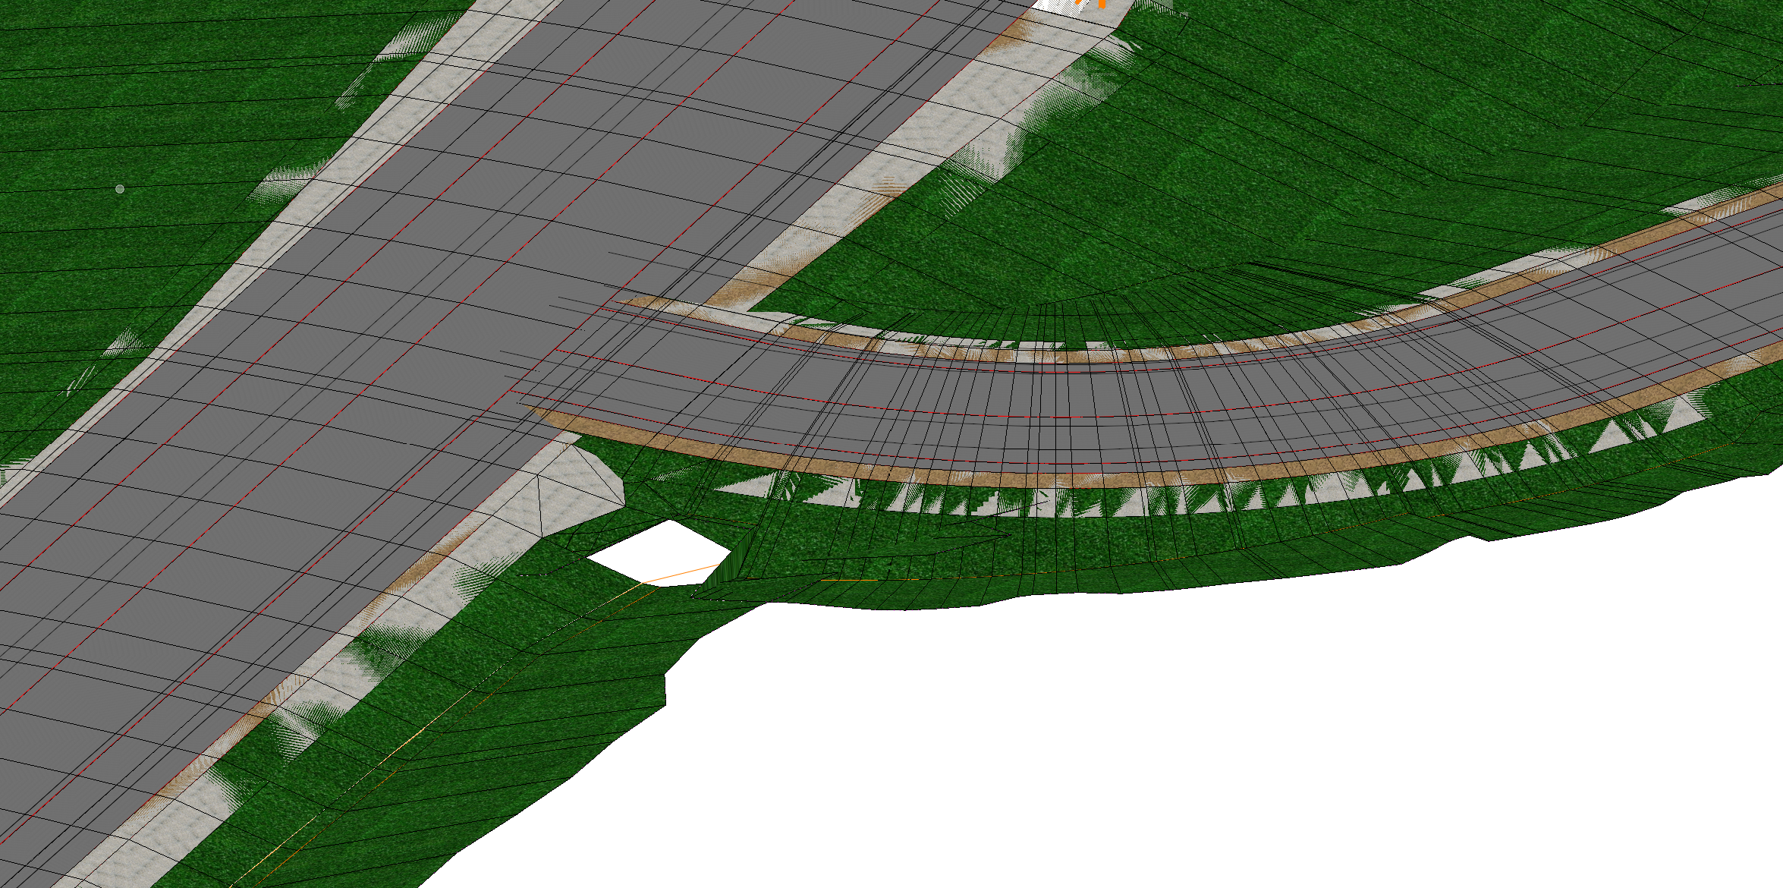
Digging into the New Worksheet - Preliminary Modeling
Grading
Convey all design intent / measure accurate impacts
Recommended to model
Guardrail locations
Side slopes
Berms / ditches
Walls
Quantities is for both the left and right slopes
Not Recommended to Model
Transition slopes
Design or tie in ditches
Headwalls
Guardrail End Treatments
Always Exceptions –
TALK TO YOUR PROJECT MANAGER!

Slide 20
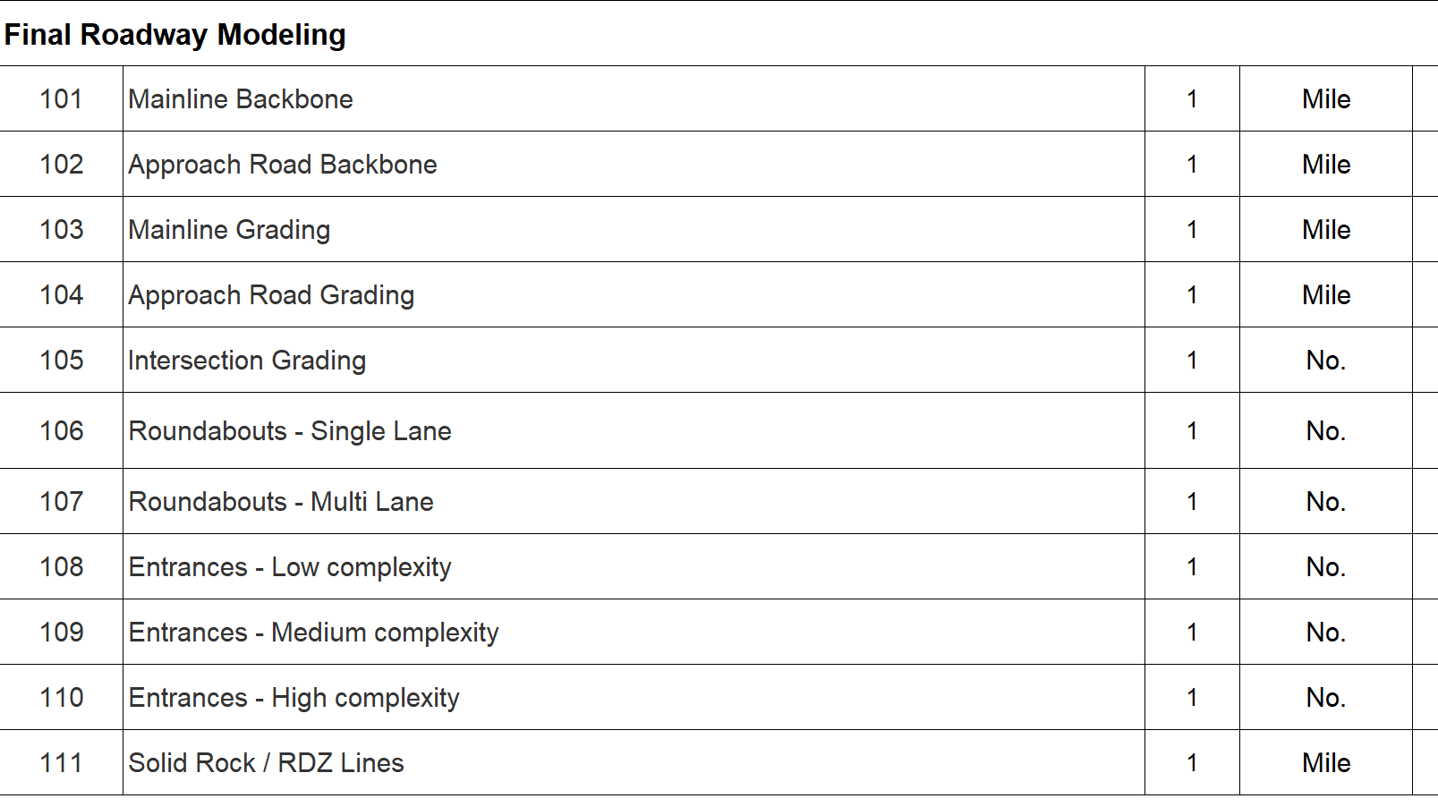
Digging into the New Worksheet - Phase 2
PDF’s are still the deliverable
(for now)
Finding that modeling is more effort, not harder
Modeling effort should match production hours
Plans and Cross Sections still challenging

Slide 21
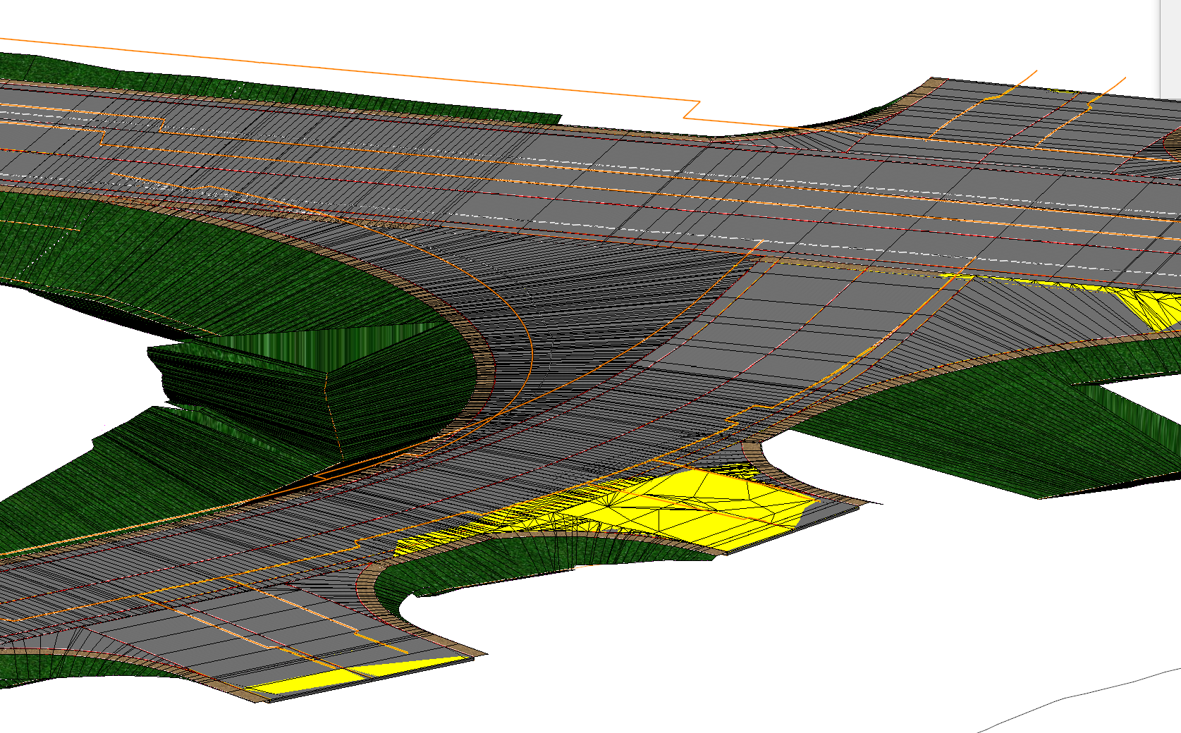
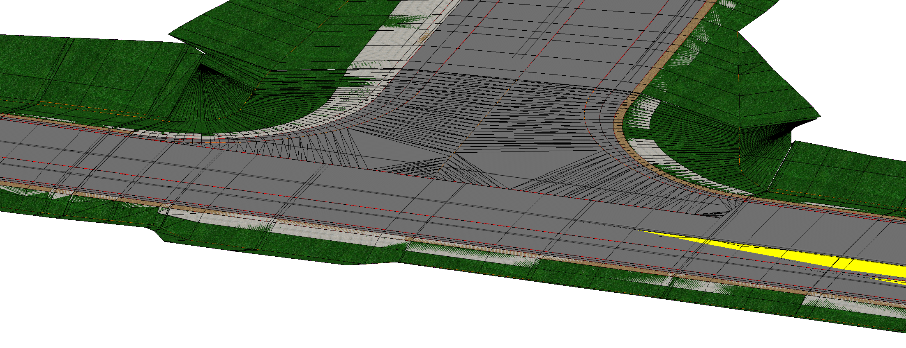
Digging into the New Worksheet - Phase 2
Final Backbone
Very Similar to Phase 1
Level & Wedging
Any additional details
Final Grading
Modeling Ditch
Slope transitions
Walls
Intersection Grading
All radii work
Unit assumes per radii
(unit 2 for T approach)
RESEARCH
ABSTRACT
DESIGN

Slide 22
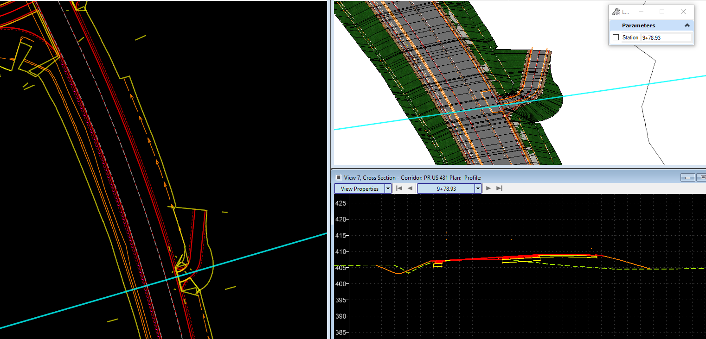
Digging into the New Worksheet
- Final Model
Entrances
Low is a very simple entrance
No radii expected
Medium is a standard entrance
Model radii
High is very complex
Level & Wedge
Complicated drainage
Rock / RDZ Line

Slide 23
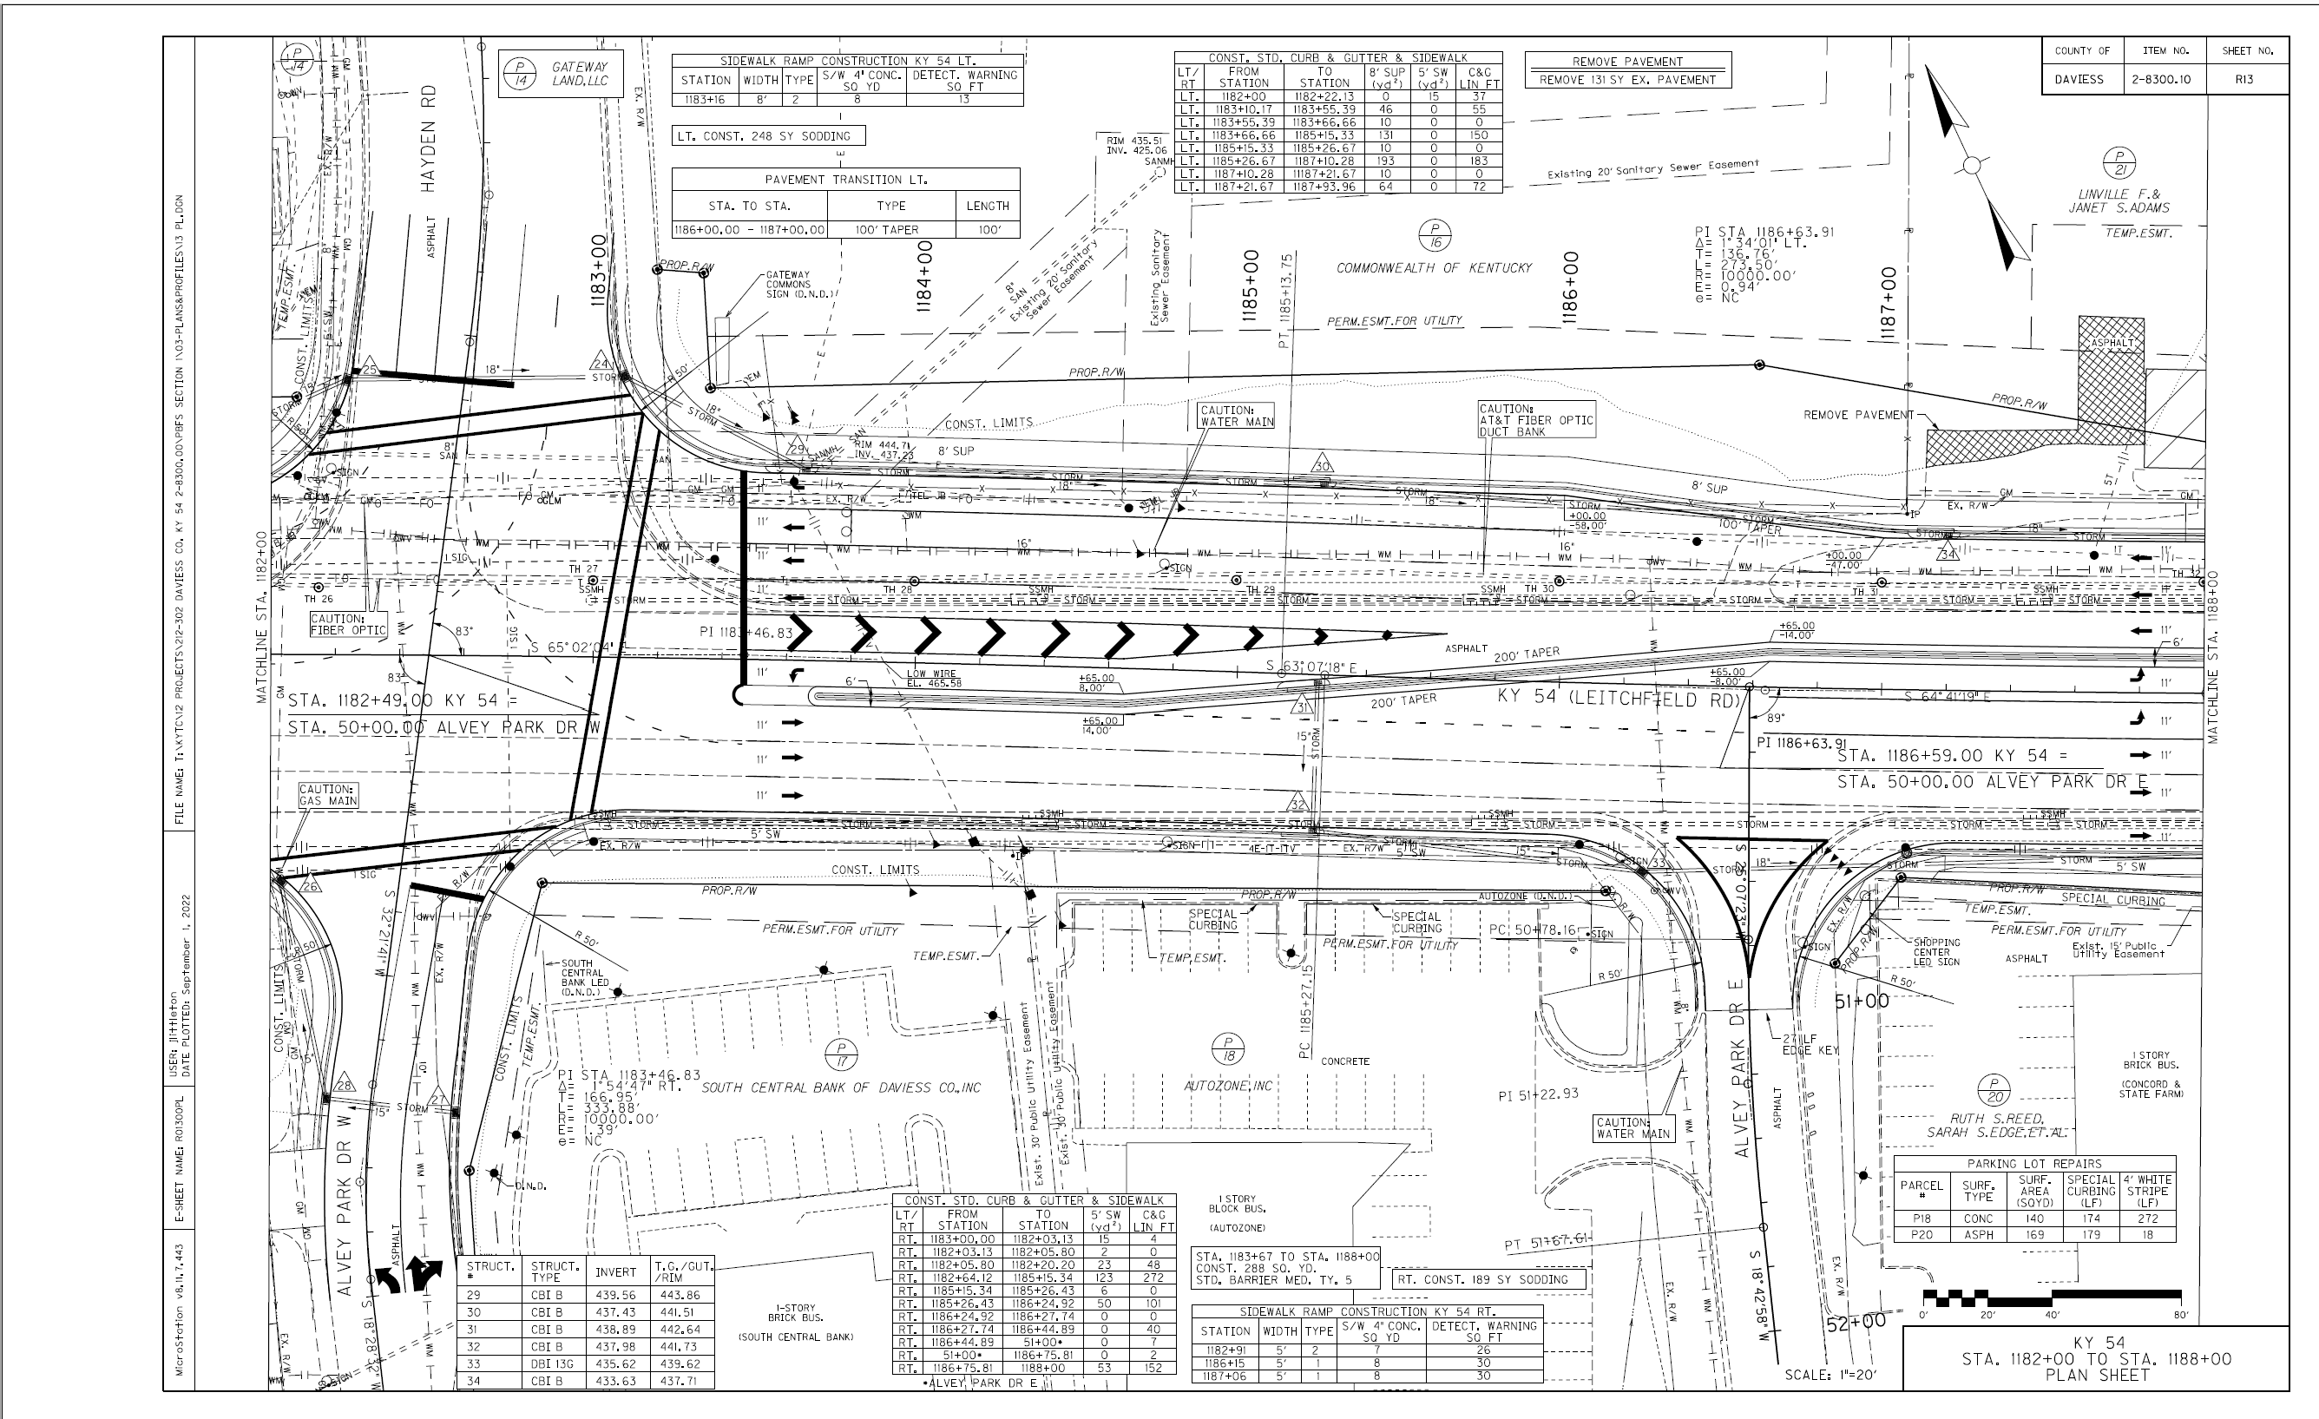
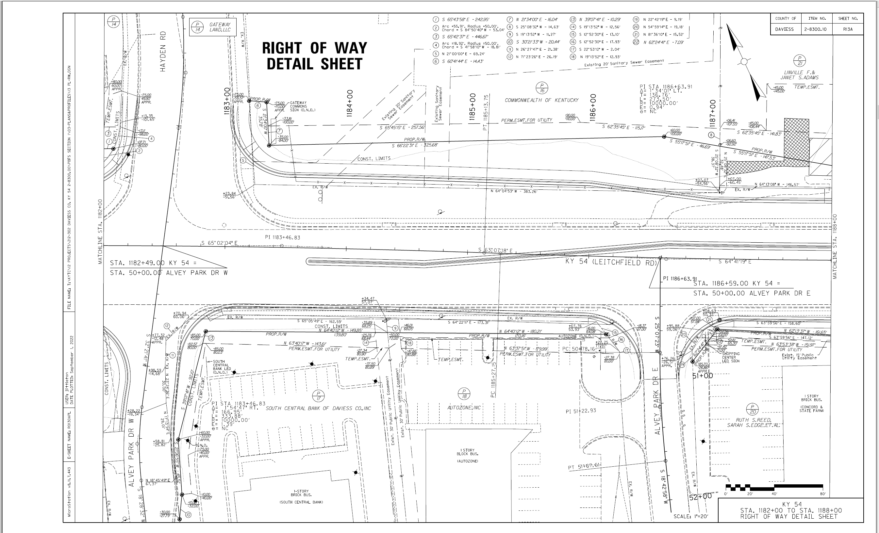
COMPANY OVERVIEW
New Worksheet - Right of Way
Allowed for Additional Right of Way Plan Sheets

Slide 24
Digging into the New Worksheet - Final Plan Set
Rearranged
Understand the greater effort level on cross sections / plan sheets
Working to reduce effort
Working to add additional direction for deliverables
Utilities
Geotech
Final
Taking a hard look at final deliverables

Slide 25
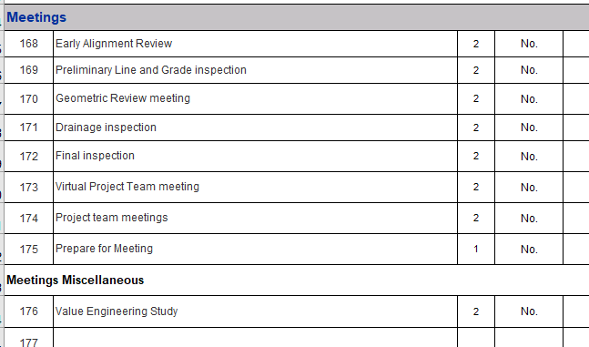
Digging into the New Worksheet - Meetings
Added a few meetings
Early Alignment Review
Between NTP and PL&G
Geometric Review Meeting
After PL&G - after refining alignment before drainage design
Prepare for Meeting now separate

Slide 26
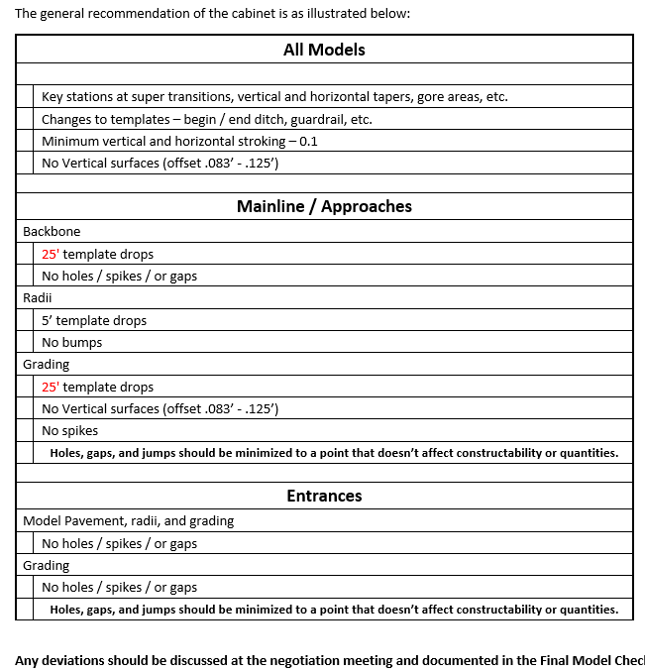
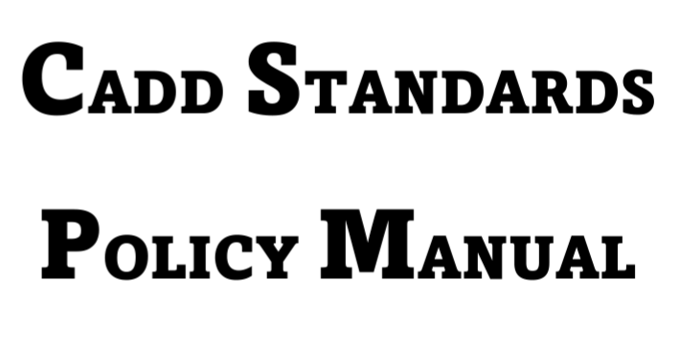
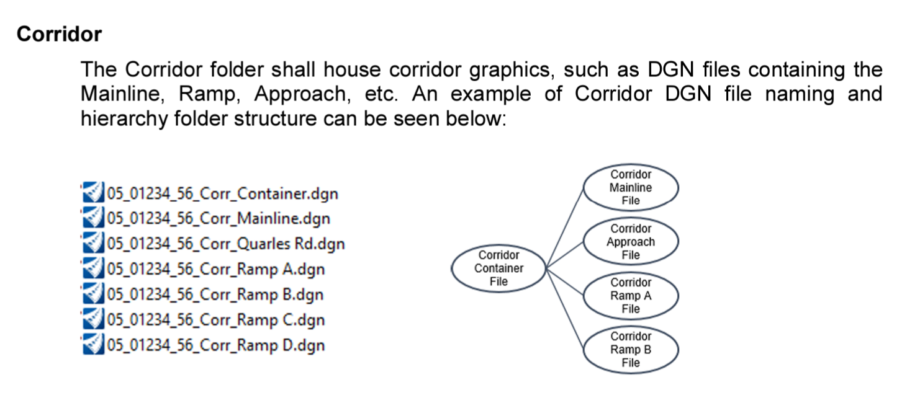
Model Submittals
Final Modeling should not match Production Hour Worksheet
Models shall be submitted to match
PDF’s are still legal document
3d model is supplemental data

Slide 27
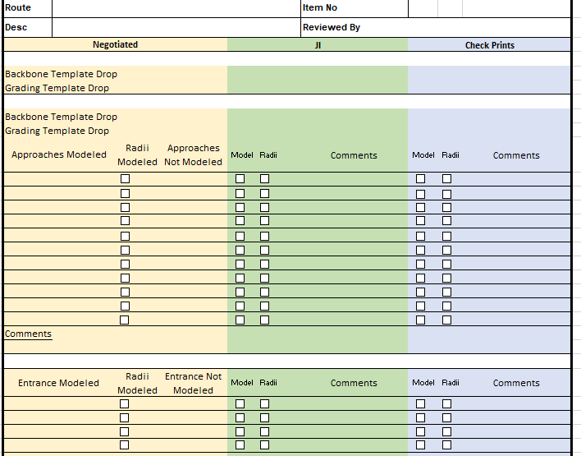
Model Submittals
Complete Model Submittal Checklist when negotiating Phase 2
Will Check at:
Joint Inspection
Soft Check – no standards required
Check Prints
Need to meet requirements
Will send Design Memo once finalized

Slide 28
ORD Expectations
Submit a quality set of plans and model that matches scope and hours
Communication has never been more important
Setting expectations
Communicate
Communicate
Communicate

Slide 29
COMPANY OVERVIEW
Contact Information
Kentucky Transportation Cabinet
200 Mero Street
Frankfort, KY 40622
Eric Pelfrey, P.E.
Director, Professional Services
eric.pelfrey@ky.gov
502.782.5108
Matt Sipes
TEBM, Highway Design
matthew.sipes@ky.gov
502.782.4899

